Slide 1
Digitalization of Material Gate pass e-MGP
09-May-2024
Developed by C&IT

Slide 2
Digitization of Material Gate pass (SIP 2024)
Discrepancy observed during vigilance investigation where in material Gate pass Form 157 was found forged in one of the project cases.
Subsequently a directive from MOS was received for digitizing the Material Gate pass process and linking it with bills.
A committee was formed for the same and the first deliberation was held in the first week of Feb’2024.

Slide 3
Committee Purpose :
A system for easy monitoring of items being taken in/out of plant premises.
Form 157 to take vendor’s consumable items inside
Form 158 to take vendor’s returnable items inside/ bring outside
Challan-114A to take BSP’s (Non-Returnable) items out of plant.
Challan 114B to take BSP’s (Returnable) items out of plant

Slide 4
Steps in the Process of Digitization
Form 157 & 158 Entry
Request By vendor (Permission)
Approval By OA
Vehicle Placement by Vendor
Route Card By CISF
Final Quantity received By OA
Form 158 Exit
Request By vendor (Permission)
Approval By OA
Vehicle Placement by Vendor
Final Quantity exit By CISF

Slide 5
Agencies Involved
Form 157/158
Vendor/Contractor
Operating Authority (OA)
CISF

Slide 6
System Flow Form 157/158
WWW
Vendor
Request Creation over Internet
OA
BSP N/W
Approval/Return/Reject
Vendor
Vehicle Entry Document
Quantity Acceptance by OA
CISF
Checking/Quantity Updation/Return
Entry /Exit

Slide 7
Salient features of the new system for Form157/158
Online entry by Contractor on internet
Allows multiple vendor requests in 1 Mat. Gate Pass
Integrating with Route Card System at Gates
Easy and Simple process at the gate for CISF
Final Quantity approval by OA for entry , CISF for exit
Material List approved by OA cannot be changed
Quantity can only be reduced
BY OA (during Approval)
BY CISF(during physical checking)
Keeping Balance of returnable items in System

Slide 8
Advantages
No forgery/changes possible on submitted documents
Labour saved : Entry of material at the gate is eliminated
Faster entry/exit of vehicles at the gate
Paper saved : O&M circular needed 4 copies of the form 157/158
Transparency : any time any agency involved can see the status of any request
CISF returnable balance maintained on System
Area Pass of vehicles can be discontinued
Data Available to Finance

Slide 9
Status
Form 157/158 system ready
114 A & B
Vendor training arranged
OA , Stores & CISF training in progress
For exit of material already inside plant, old system will be followed.

Slide 10
Demo for Form 157 & 158

Slide 12
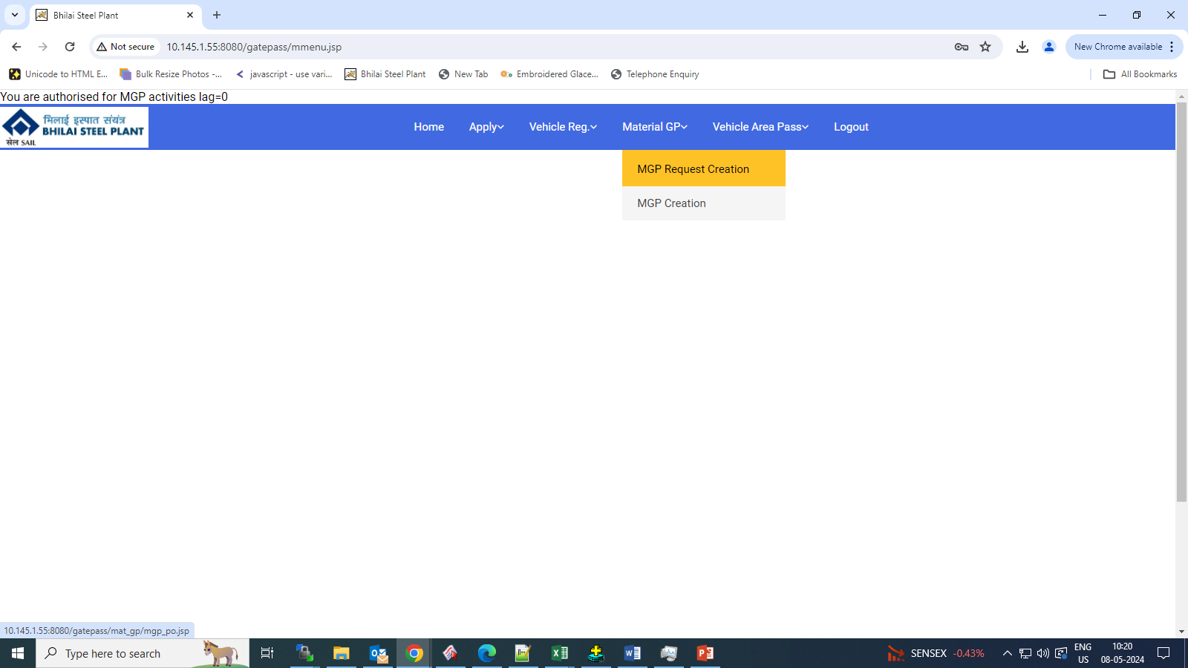

Slide 17
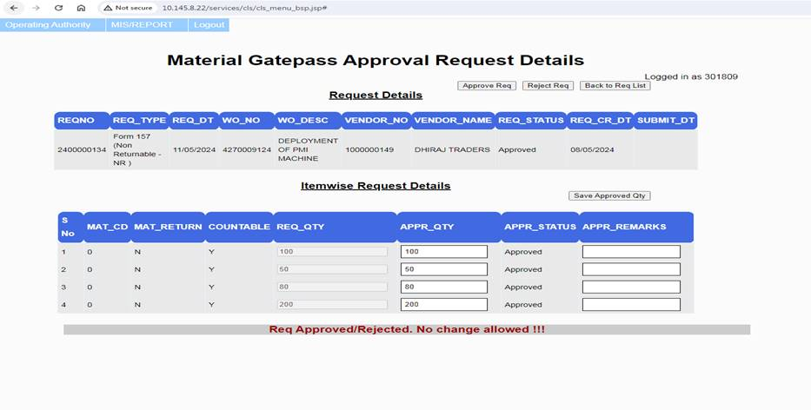

Slide 18
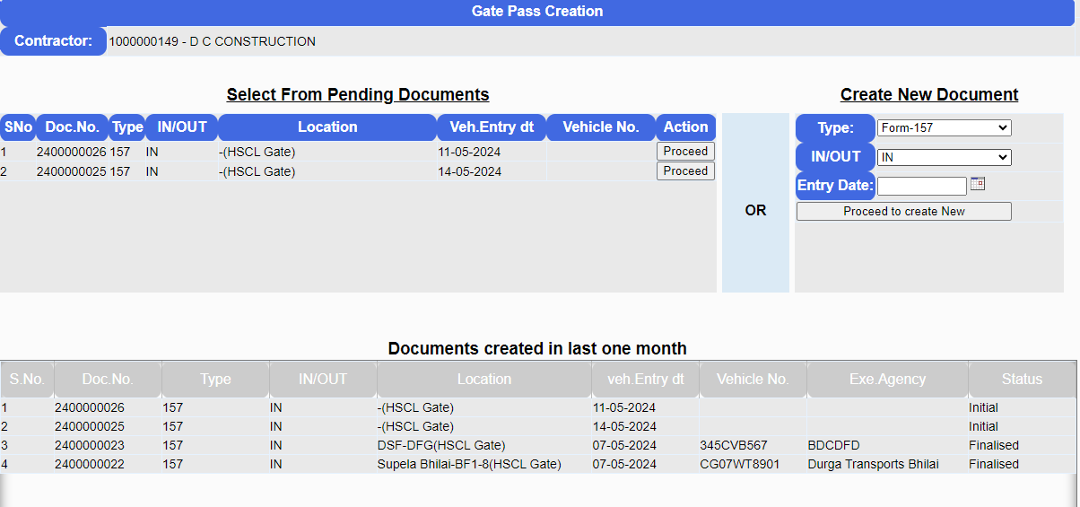

Slide 19
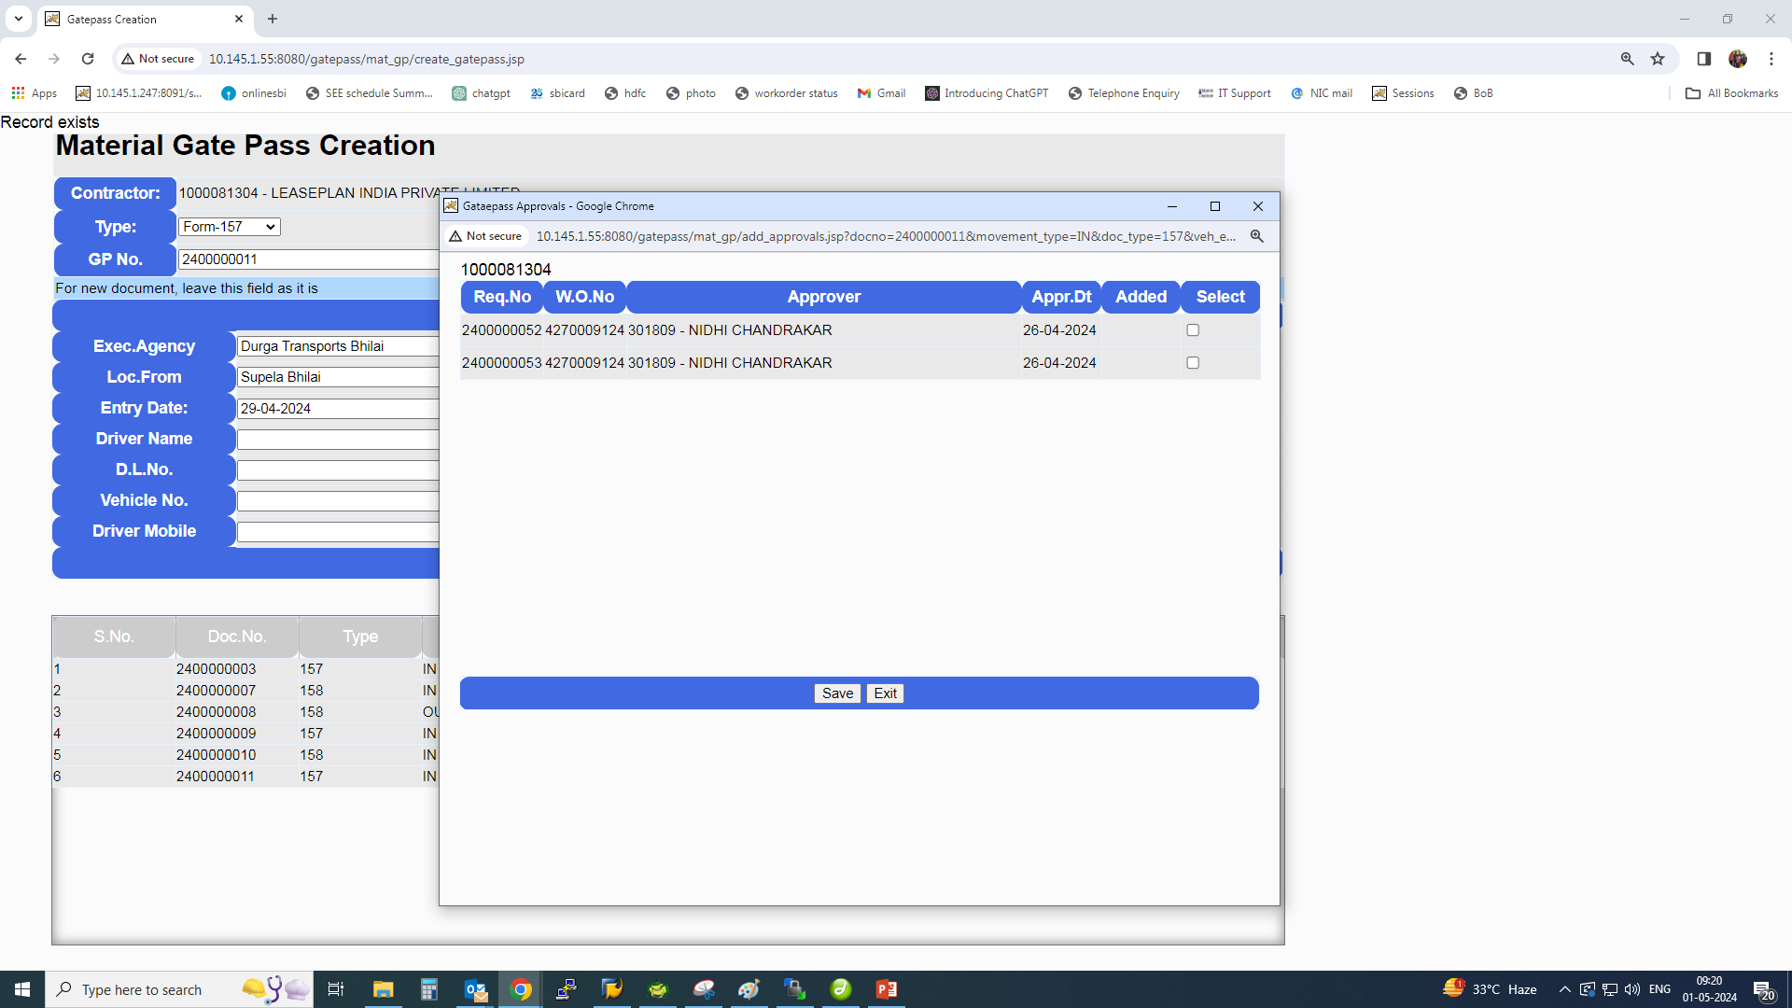

Slide 20
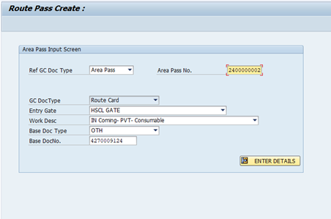

Slide 21
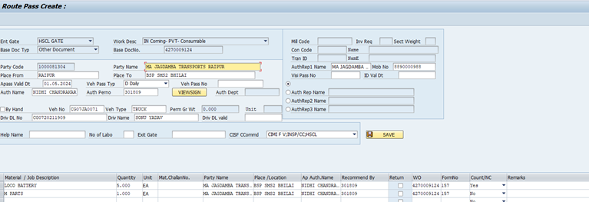

Slide 22
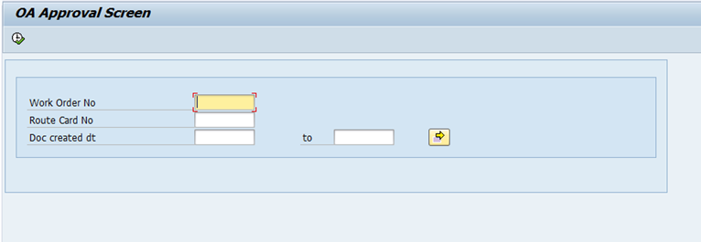

Slide 23
Material Gate Pass
O&M Forms 114A, 114B

Slide 24
Material Gate Pass 114A / 114B
Agencies Involved
Department
Stores
CISF

Slide 25
System Flow MGP 114 A/B
BSP N/W (SAP)
Department
Stock Transfer Order Creation
Store Keeper
Material Transfer Request , MGP creation
Stores I/C
MGP Approval
CISF
Checking
Exit

Slide 26
Material Gate Pass 114A / 114B
Salient features
Developed in SAP
Material Gate Pass is created from STO based Material Document
Allow multiple Material documents in 1 Mat. Gate Pass
MGP can be approved/ cancelled by Store I/c
MGP gets cancelled automatically if Material doesn’t get out on the same day
MGP can be created without reference to document also.

Slide 27
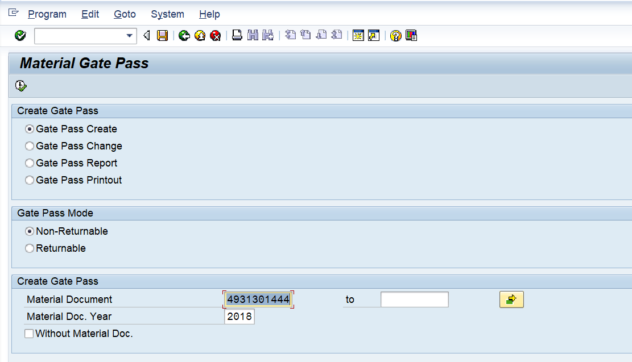
Material Gate Pass Creation
ZGATEPASS
Provision for multiple Material Docs

Slide 28
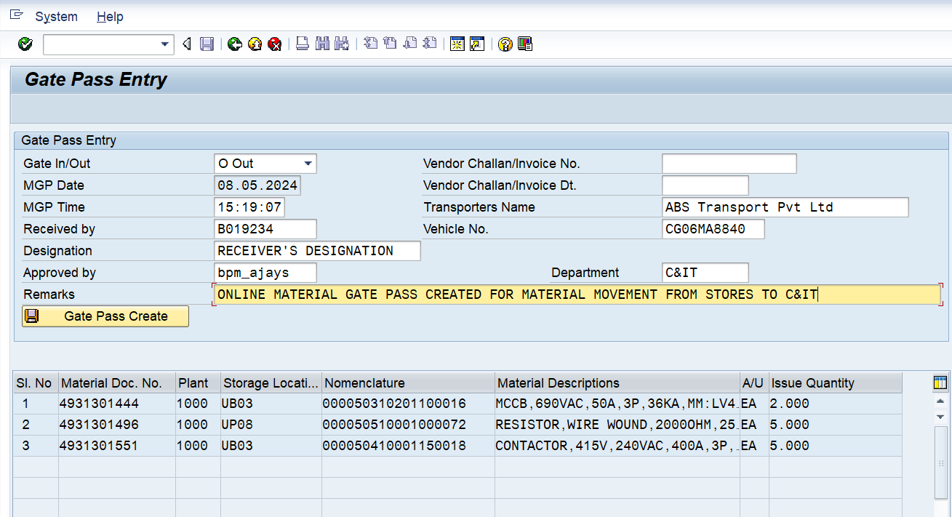

Slide 29
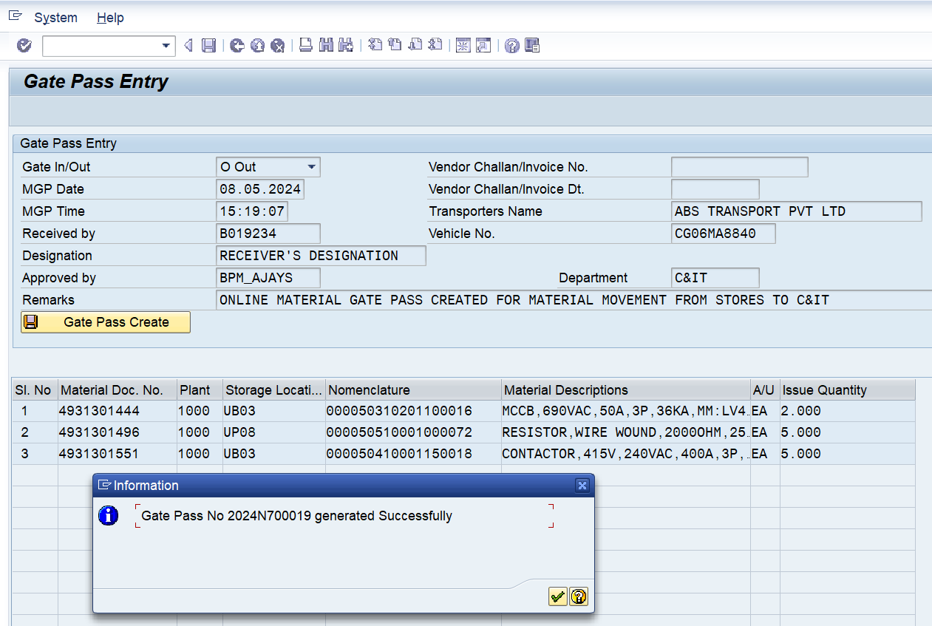

Slide 30
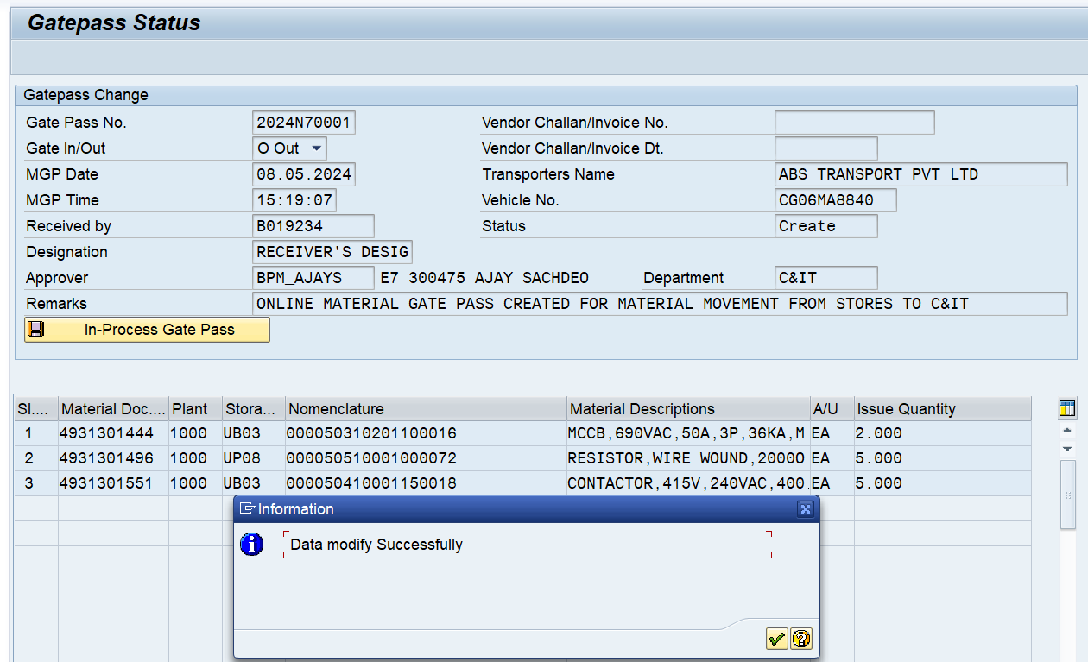
Material Gate Pass modified and released for approval

Slide 31
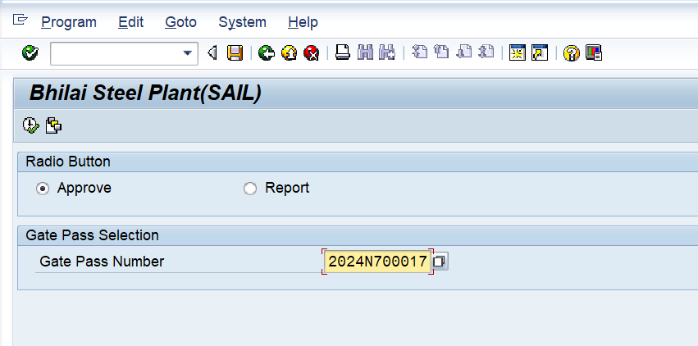
Approval of Material Gate Pass by Store I/c
Unauthorised person will get the
error message if trying to approve

Slide 32
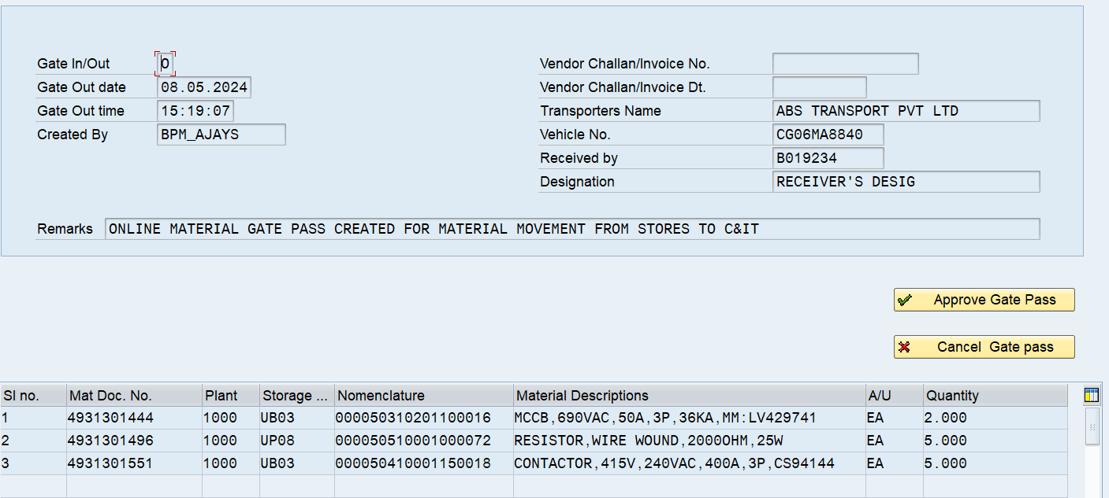
Approval of Material Gate Pass by Store I/c

Slide 33
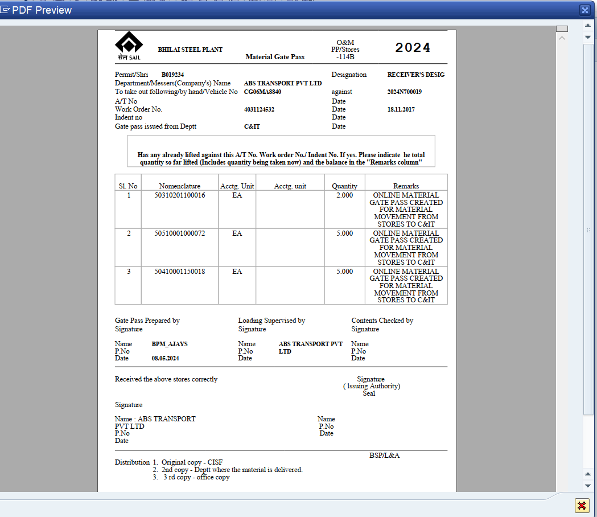
Gate Pass Printout

